Slide 1
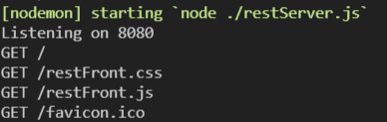
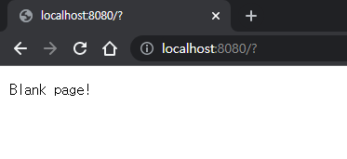
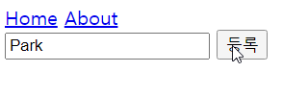
1) Enter http://localhost:8080
🙂 Server responds with ‘restFront.html’
2) ‘restFront.html’ need these files.
Client requests them to server
🙁 Server doesn’t respond → blank page
restFront.html <form> redirects to ‘/’
when submit button is clicked
(= restFront.js is not working!)

Slide 2
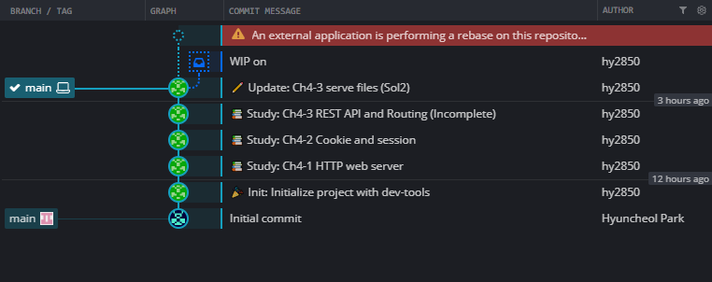
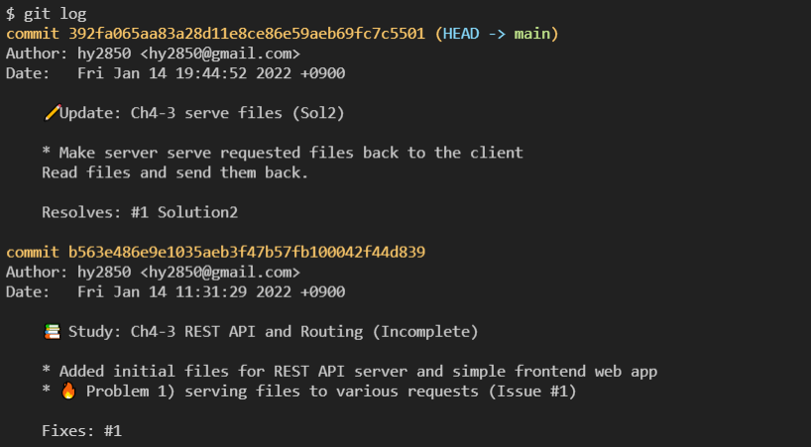
I want to change
message of this commit
git rebase --interactive 'b563e486^‘
(rebase to commit ‘before’ b563e486)

Slide 3
